Slide 1
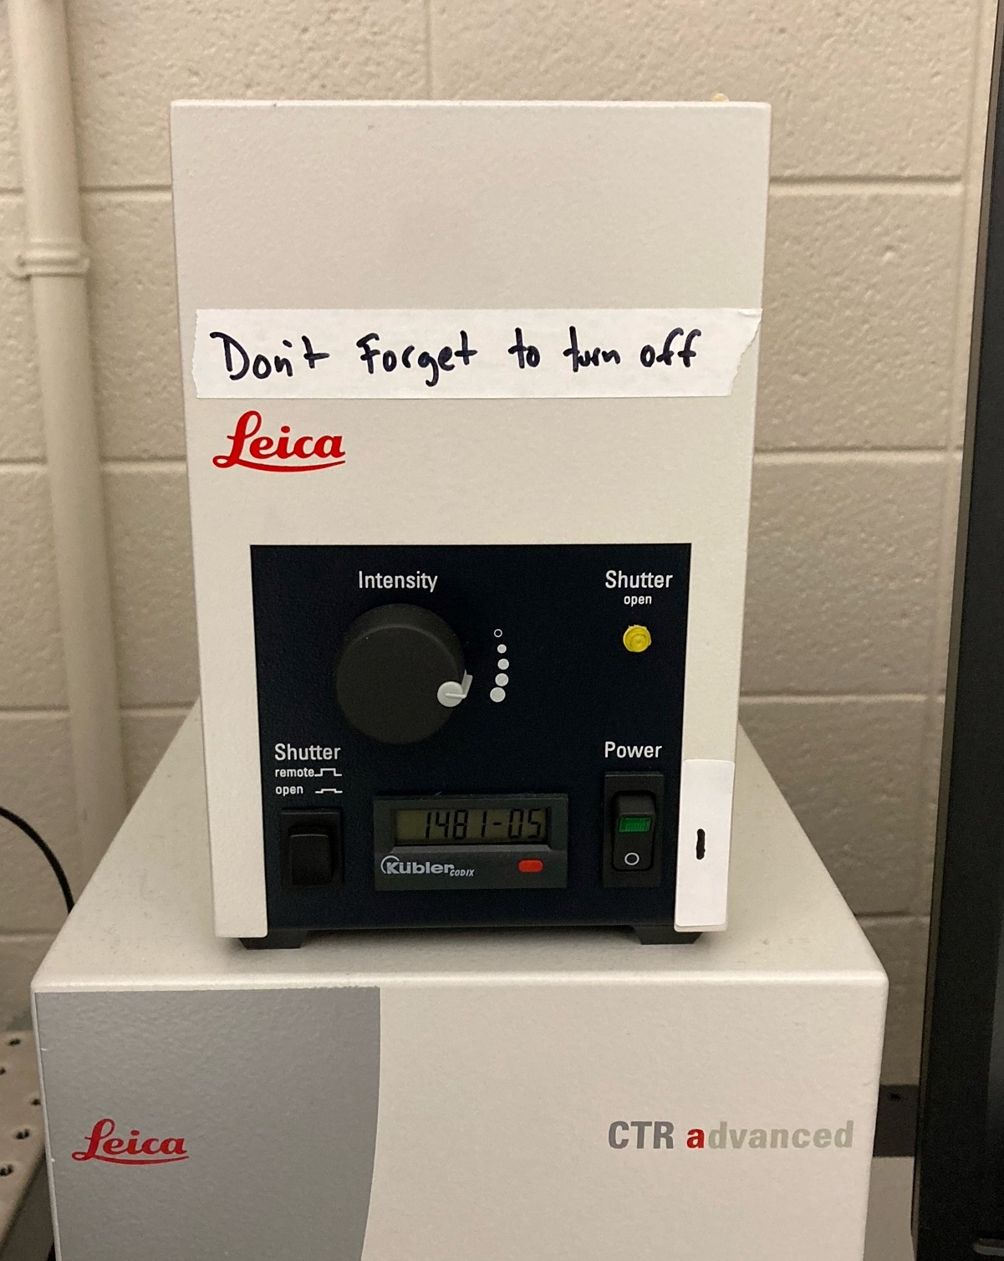
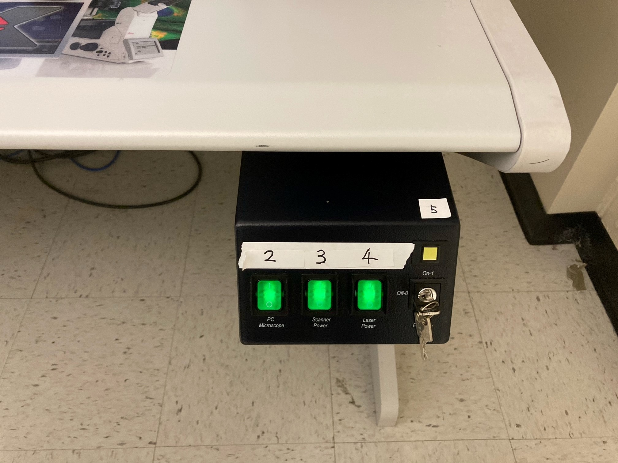
Leica SP8 System startup
1. Turn on the hardware
Turn on the Arc lamp power source (#1): The green power light and the yellow shutter light will come on. The first and second intensity levels are usually sufficient to observe fluorescence through the eyepieces. Then switch on the microscope/PC (#2), scanner power (#3), laser cooling power (#4) and turn the laser key (#5) clockwise from OFF to ON.
1
Note: make sure that the stage is clear. That means that the stage insert is off the scanning stage and the objectives are not in a position where they could collide with the stage. This is necessary because the stage will move around to calibrate itself when you power up the system.
The lamp should remain on for a minimum of 30 minutes. Do not turn the lamp off if another user is scheduled within 2 hours after your use.
2
3
4
5

Slide 2
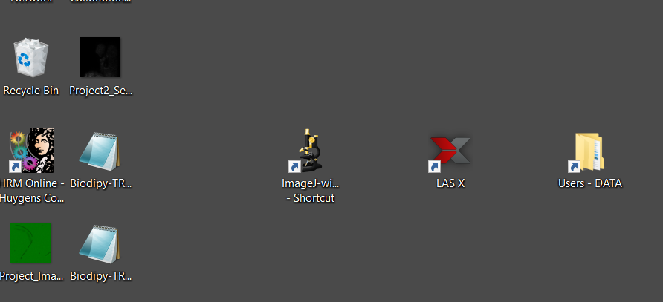
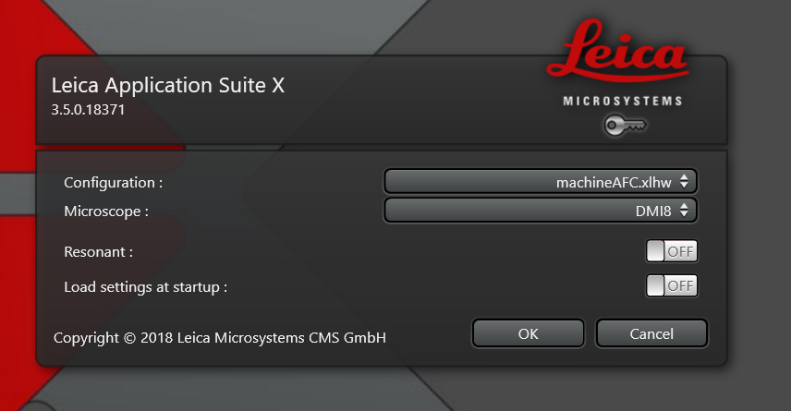
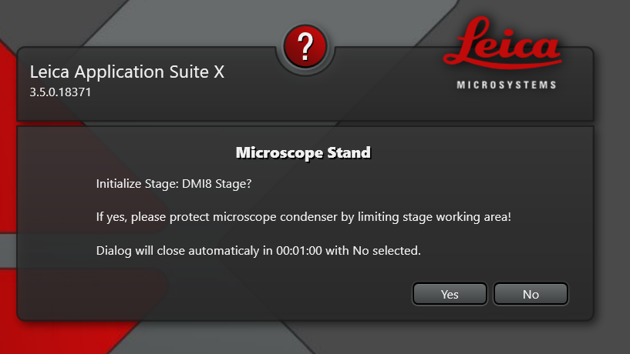
2. Start the LAS X software
Open LAS X software using desktop Icon.
The “Resonant” switch gives you the option the use the Resonance scanner, which you would want if you were doing time-lapse imaging of something very fast. However, you also cannot switch back and forth between Resonance and regular scan modes once the software is running; you make that choice for one or the other at startup.
When prompted about Stage Initialization click Yes only if you plan to use Tiling or Mulit-position Scan features, otherwise click No!
If clicking Yes, make sure the stage cannot hit the condenser or objective lens!

Slide 3
Leica SP8 System Shutdown
Please inform the Imagine Core Manager if any microscope function goes wrong before you try to fix it yourself!
Arc Lamp cannot be turned on within 30 minutes after being switched off.
1. Save all your images. Smaller experiments can be stored locally D:\User Data\<your folder>\ for loading microscope settings (“Apply”); save all your data to your Ole miss Box (suggested) or flash drive.
2. Turn off the Arc Lamp (#1).
3. Make sure that all lasers are switched off in the software by unchecking the laser boxes in the “Configuration-Lasers” panel.Rotate the laser emission key to the ‘Off’ position (#5).
4. Close the software.
5. Record the ending time and submit the usage time.
6. Remove your sample and clean the objective lenses. Move objectives down with coarse focus, switch to 10x dry lens.
7. Shut down the computer from the software (Windows).
8. After the computer is completely off, Switch off Scanner Power (#3) and the PC/Microscope power(#2).
9. Switch off Laser cooling Power #4 (make sure the laser key is off).

Slide 4
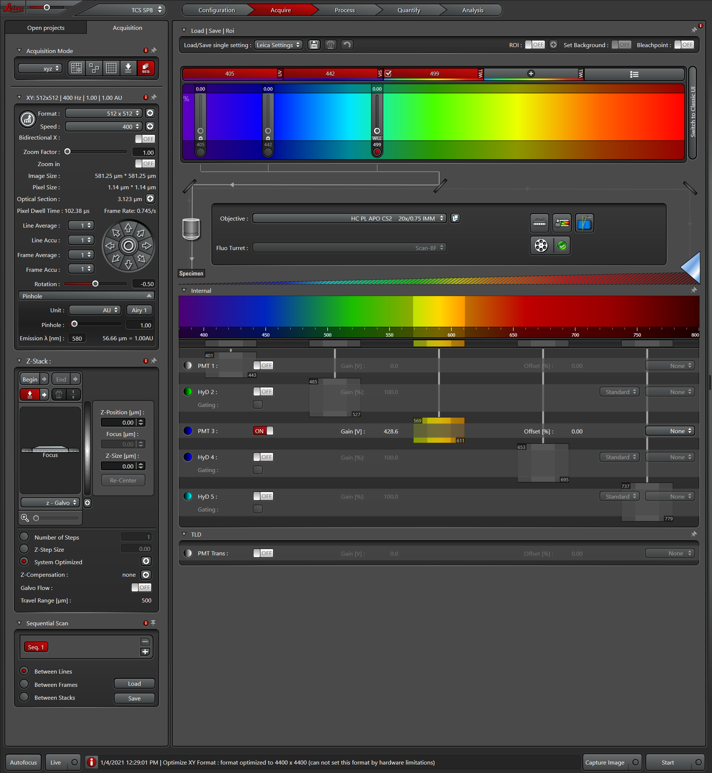
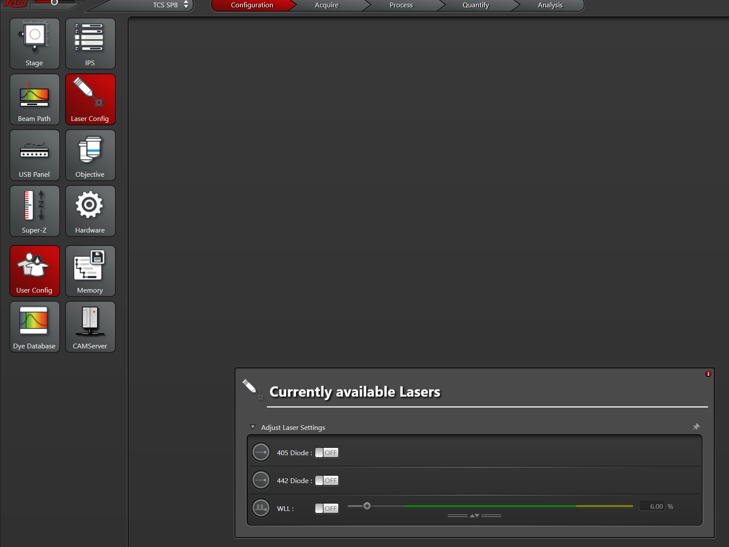
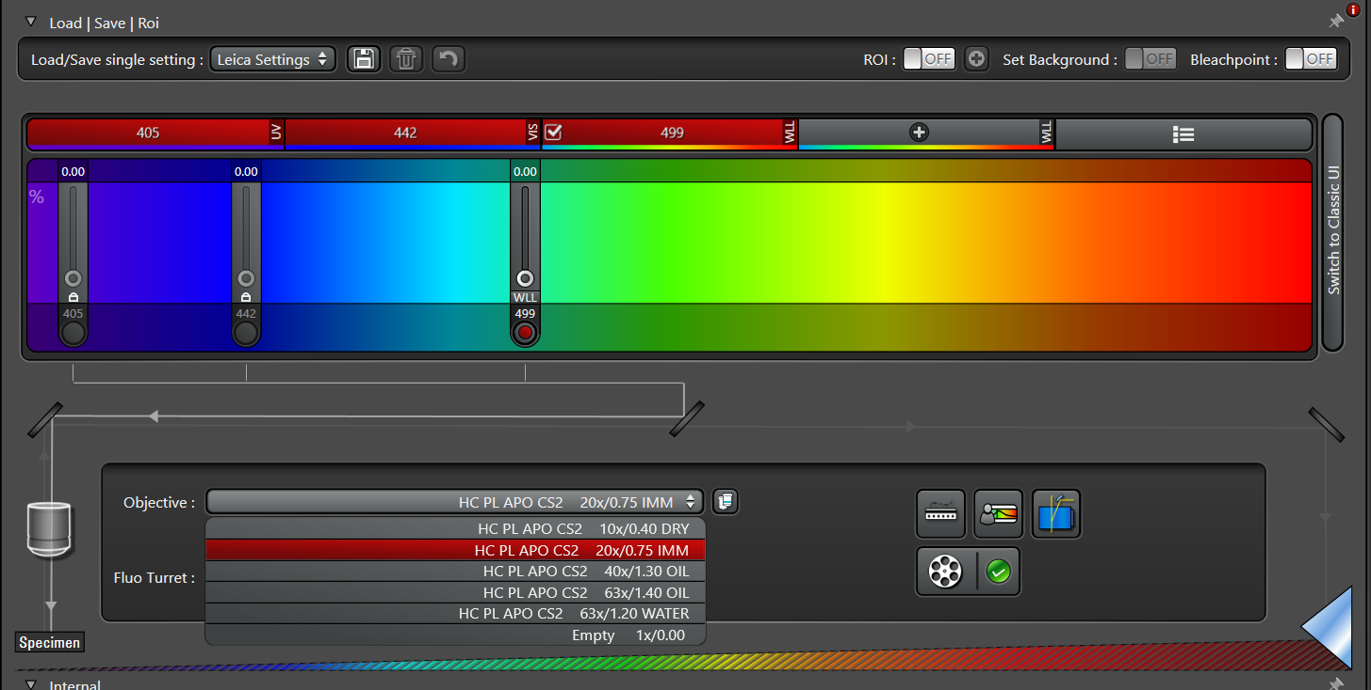
Select Laser(s) and Objective lens
Main tabs
The default layout of the LAS X is the Acquire control panel.
Laser settings
Select Laser(s) in the ‘configuration’ panel. Switch the selected laser(s) to ‘On’.
Acquisition settings
Objective settings
PMT detectors settings
405 nm Diode Laser
442 nm Diode Laser
White Light Laser: 470~670 nm
Select Objective lens in the list of ‘Objective settings’

Slide 5
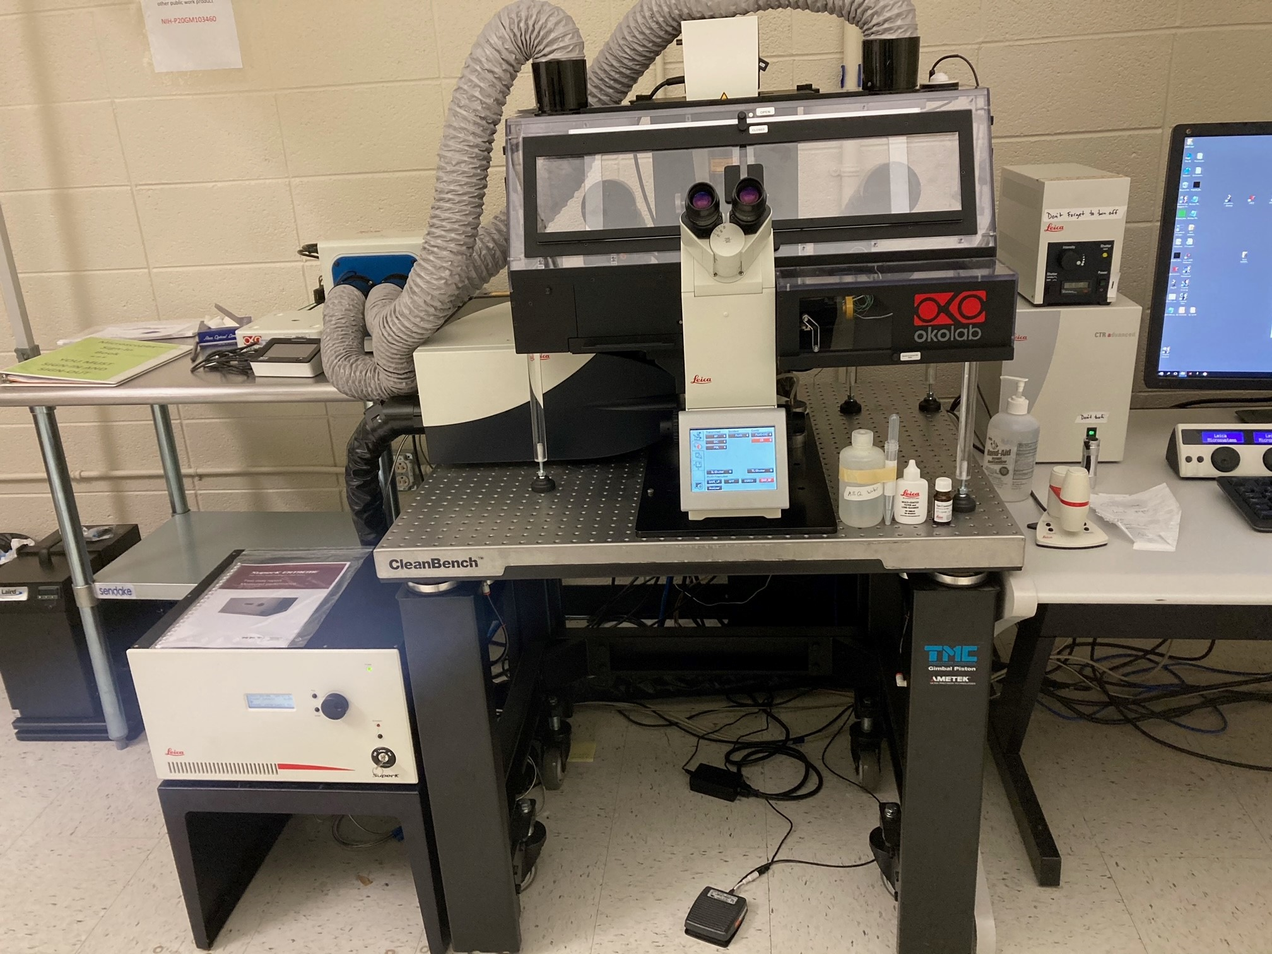
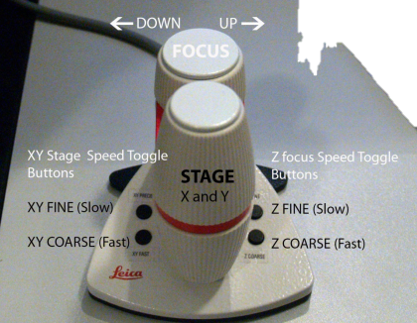
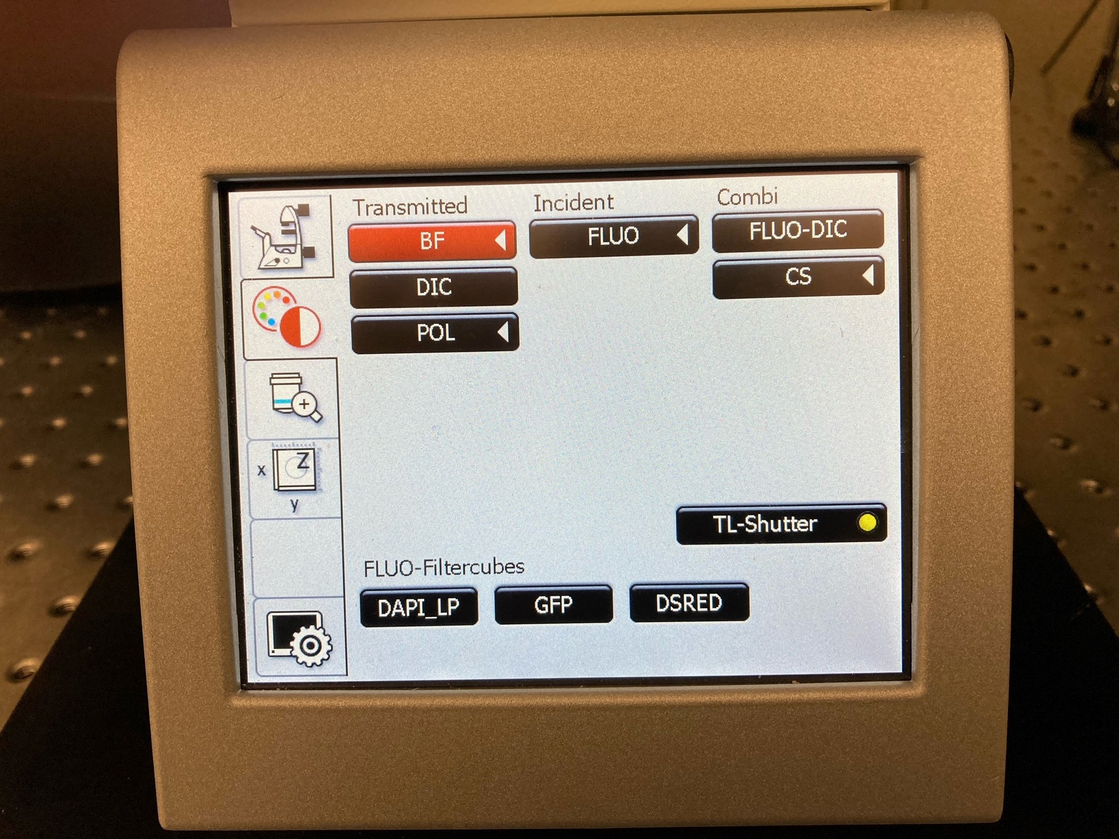
Find Sample through Eyepieces
Please clean up the objective lens with ‘cleaning solution’ and ‘lens paper’ before and after usage the system
Chamber LED light
Lens Paper
Mount the sample on the sample holder, select and put the immersion solution (dry/water/oil) on the objective lens, and use the ‘smartmove controller’ to locate the sample through Eyepieces.
Control Panel
Cleaning Solution
SmartMove Controller
Water
ImmersionOil
Select the ‘bright field (BF)’ and ‘fluorescence (FLUO)’ mode through the control panel touch screen. Turn on the ‘transmitted shutter (TL-shutter)’ at BF mode. Select ‘FLUOR-Filtercubes’ at FLUO mode.
Chamber LED light Power
NOTE: Do not use other tissues to clean up objective lens (Lens paper only).

Slide 6
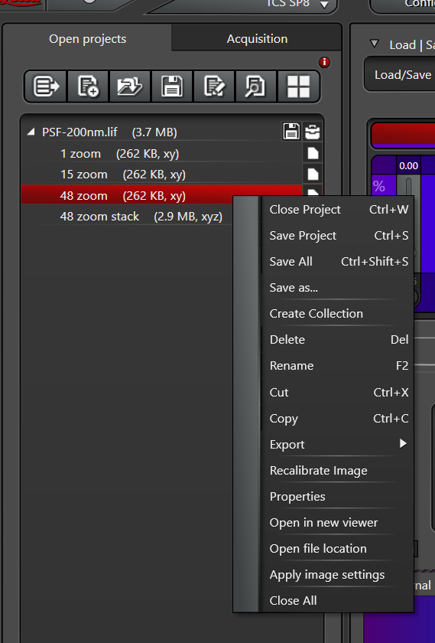
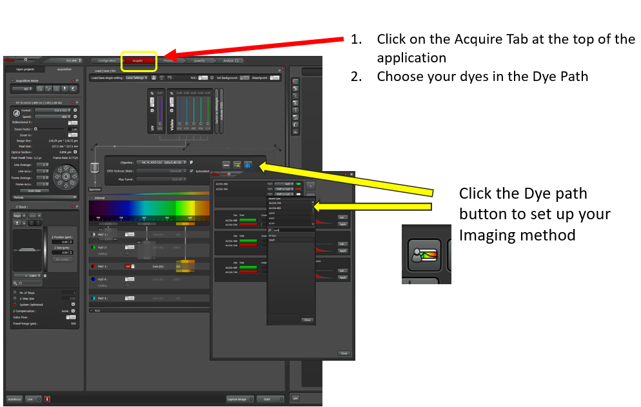
Load Your Imaging Method
NOTE: The method must be set up by the Imaging Core Manager and you must be trained to use the method.
The easiest way of loading a method is to ‘open’ a previously saved .lif file under the “Acquire-Open Projects”, select the desired image and then click the ‘Apply’ button.
Or:

Slide 7
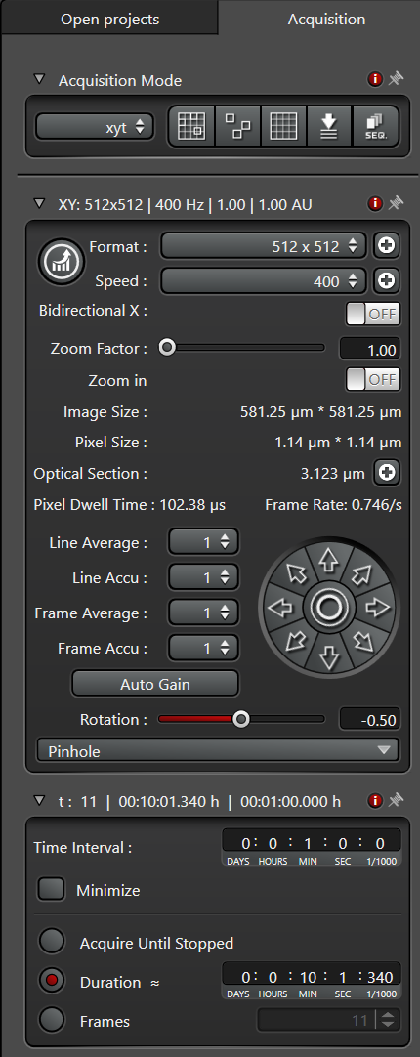
Image Acquisition
Select the Imaging Mode
Set Line or Frame Average and Line or Frame Accu (accumulation) to achieve better SNR for week fluorescence signals.
Set the Resolution
Set the Zoom
The orientation of the acquired image may appear differently than the view through the eyepieces. This is dependent on the setup of the field “Rotation”
Set the Pinhole, usually the default (1 Airy Disk) is used for confocal imaging.
Live
Capture Image
Start
‘Live’ is continuous imaging for finding the Region of interest (ROI), optimizing imaging conditions (Images will not be saved).
‘Capture image’ is used to save single image.
‘Start’ is used to save image stacks ( Z-stack, time lapse, tiling etc.)
NOTE: Pixel size must be ½ the expected particle size

Slide 8
Tuning the Laser(s)
Laser Intensity
Add new laser line(s)
Wavelength
Fixed
Shutter
Closed
Shutter
Opened
Three key factors during tuning laser(s):
Excitation Wavelength: 405 nm(fixed), 442 nm(fixed), WLL (adjustable 470~670 nm). ‘Add new laser (s)’ could only work in the WLL range (470~670 nm). The selected laser(s) will show up in the spectrum with its ‘control bars’.
Intensity: Laser intensity could be adjusted with ‘control bars’. Usually 405 and 442 lasers should be below10% and WLL should be below 20%
Shutter(s): Shutter(s) should be opened during imaging.
NOTE: If laser(s) is not observed during imaging, and there is no images on the screen, first to check the 3 key factors. If you still could not observe the laser(s) and images, please contact Core Manager

Slide 9
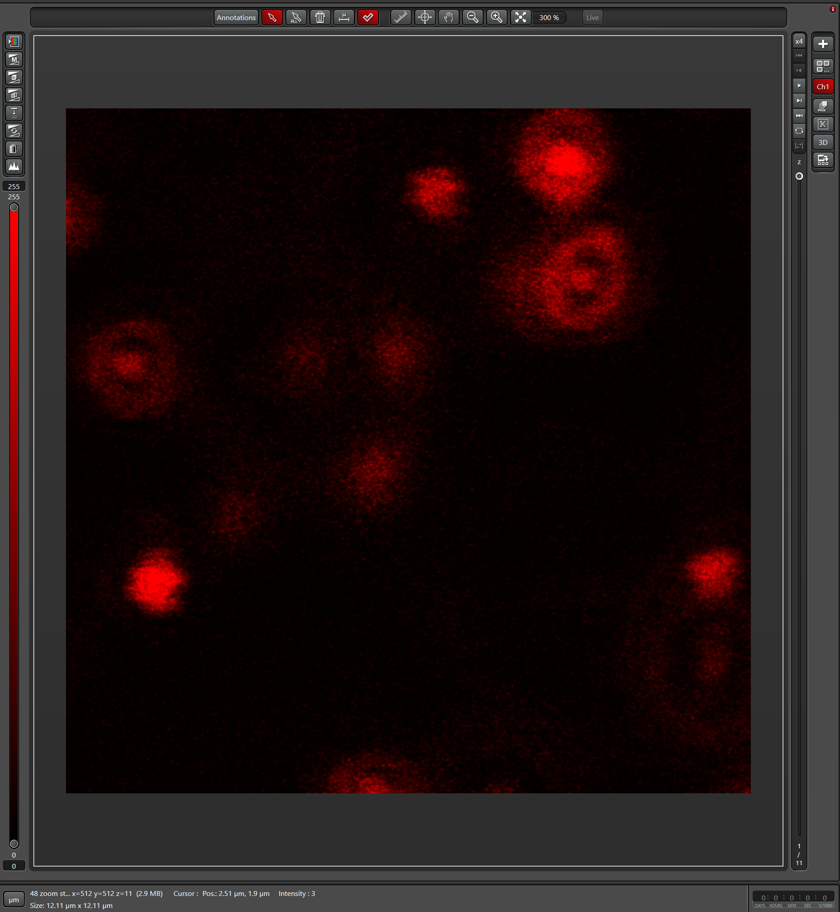
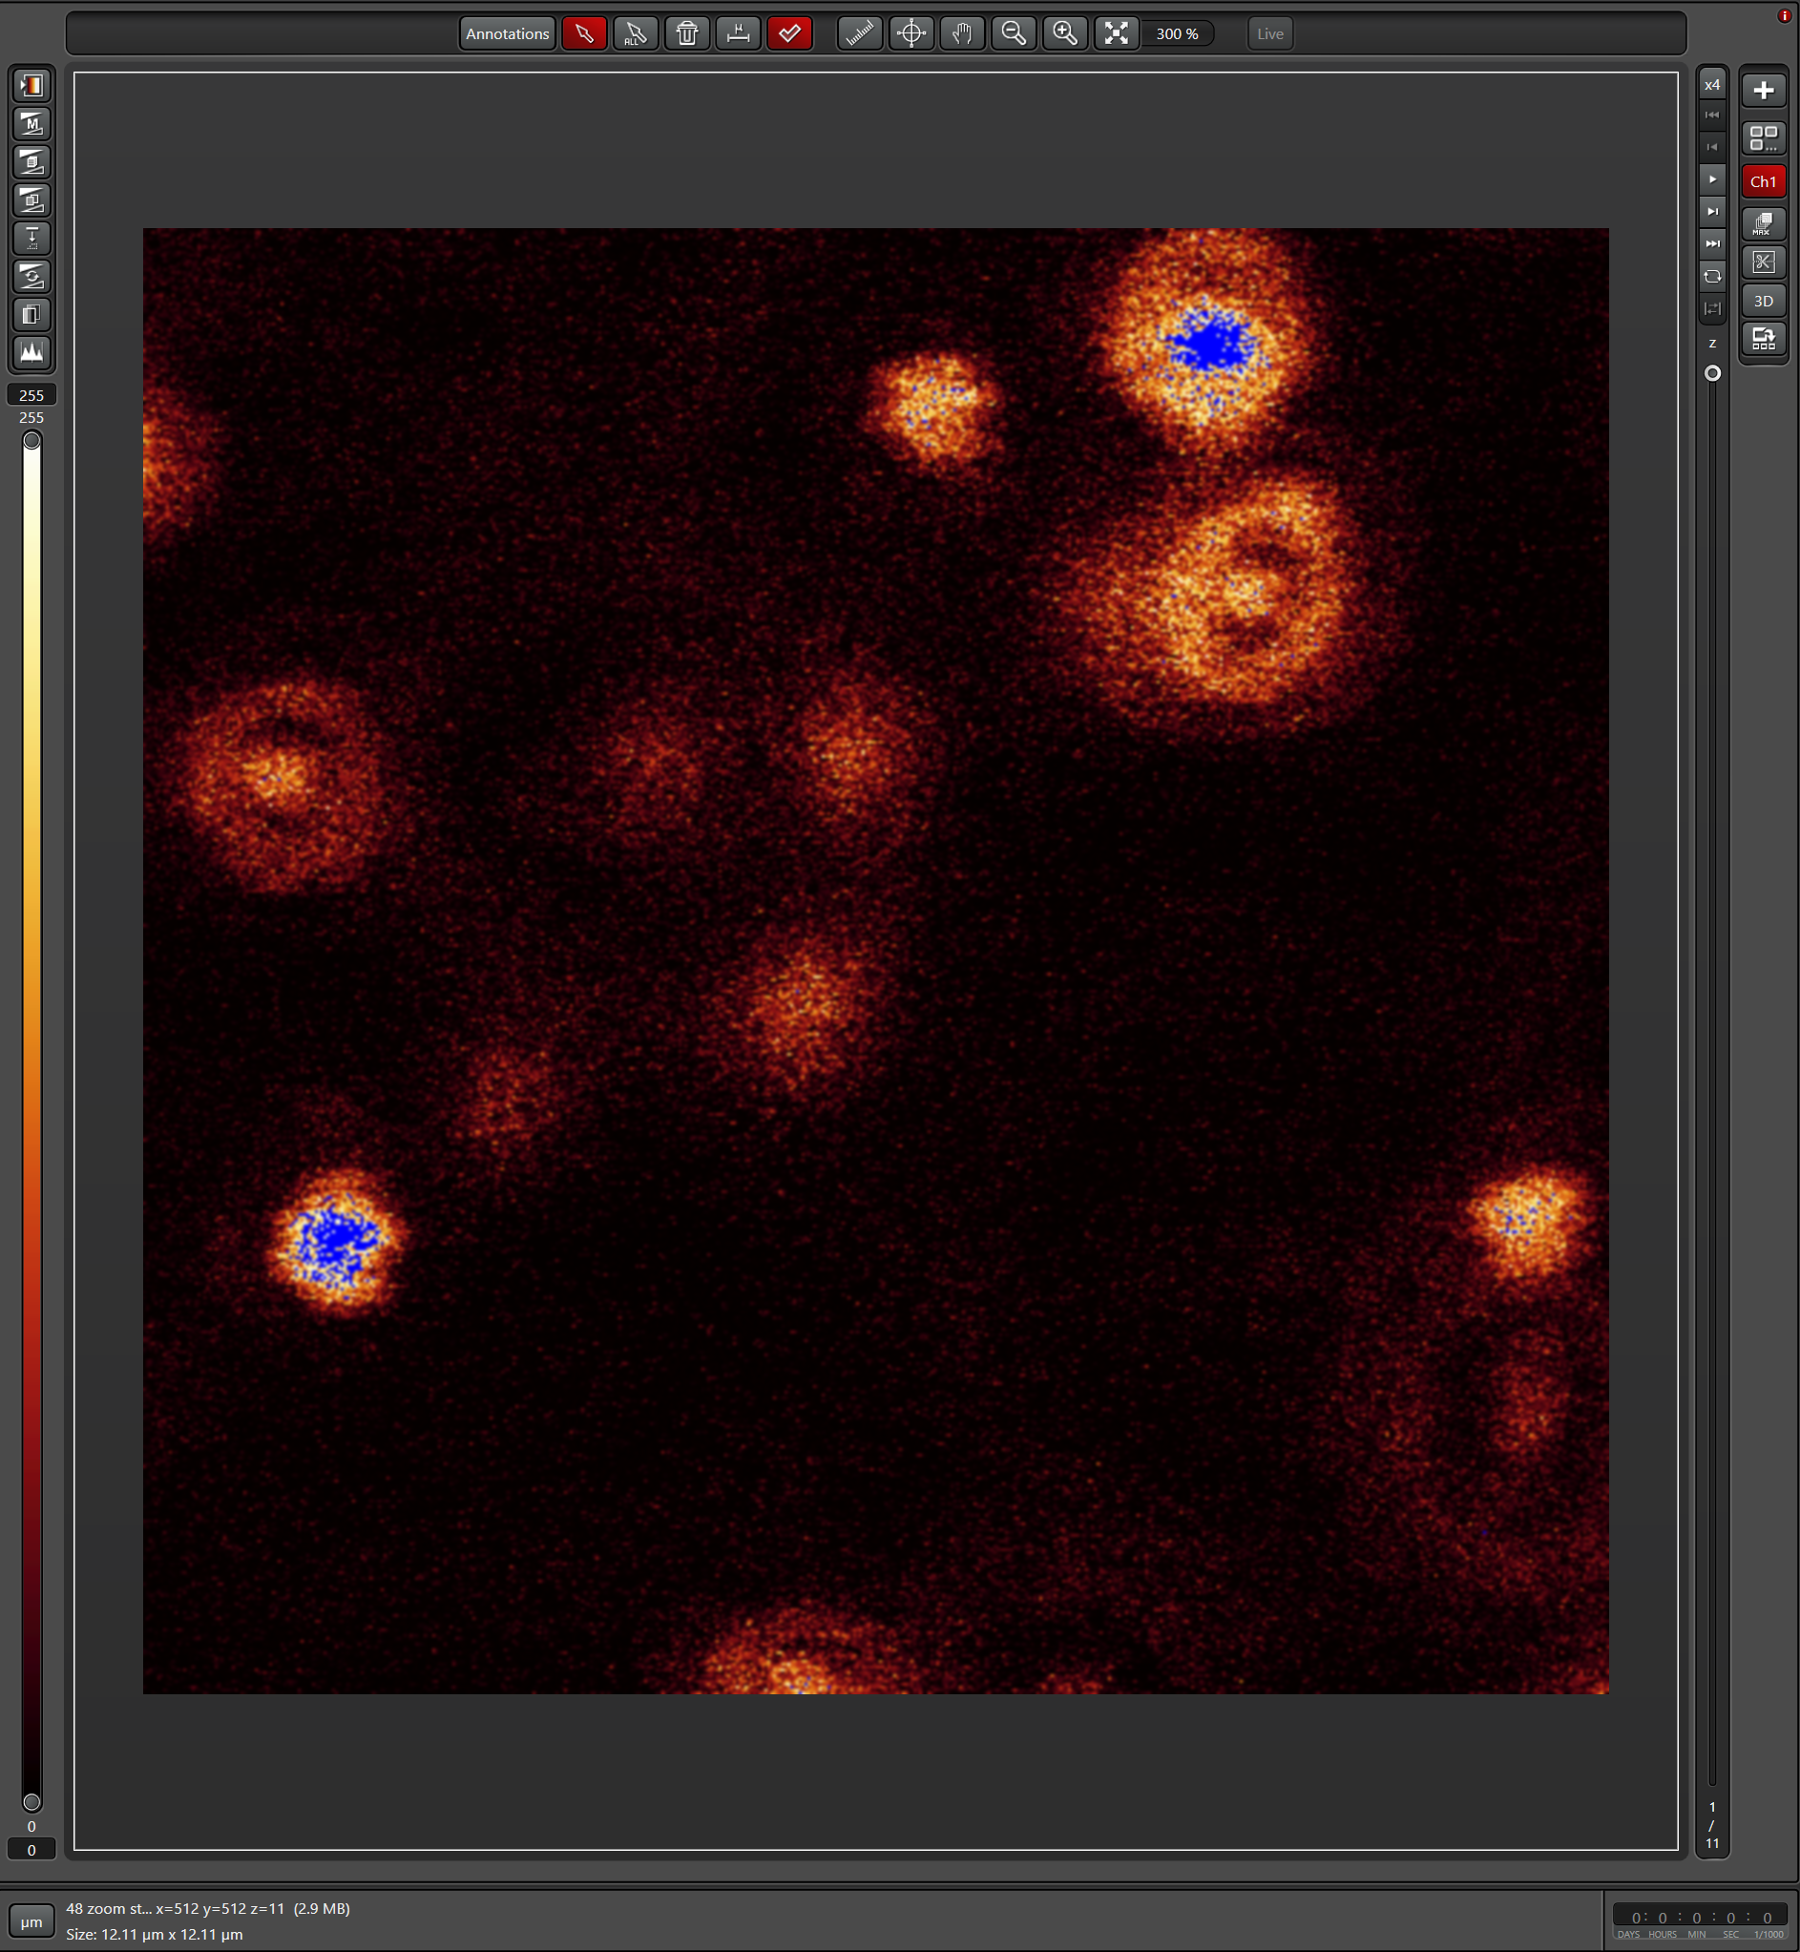
Tuning the PMT Detector(s) and Image saturation
Similar as Laser(s) tuning, there are three key factors during detector(s) tuning.
Emission Wavelength: anywhere between 400-800 nm with 1 nm tuning steps and a minimal bandwidth of 5 nm.
Gain: For PMT(s), the Gain should be typically set less than 850. For HyDs, the Gain is digital and should be typically set less than100.
Power: PMT(s) power should be on during imaging.
PMT Trans is used for transmission imaging.
Detector(s) tuning is always work collaborate with Laser Tuning. Make sure No image saturation during settings in the saturation mode, any blue dots indicate a saturation in the detector(s). It is always suggested to use lower laser power to protect samples.
Imaging colors could be selected from the Detector(s) settings.
Imaging colors
Wavelength
Settings
PMT(s)
Selection
Gain Settings
Mode switch button
General Mode
Saturation Mode
Saturated Spots
NOTE: HyDs are very sensitive and can easily get saturated, causing the trouble to the system. Get advice from Core Manager for using HyDs! HyDs are only suggested for super dim samples or in resonant scanning mode.

Slide 10
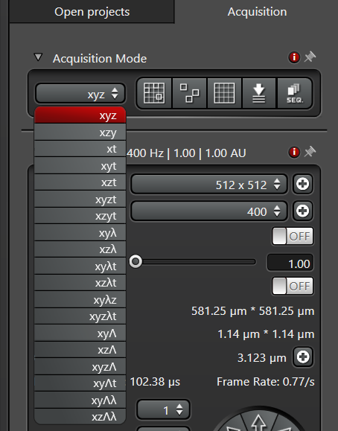
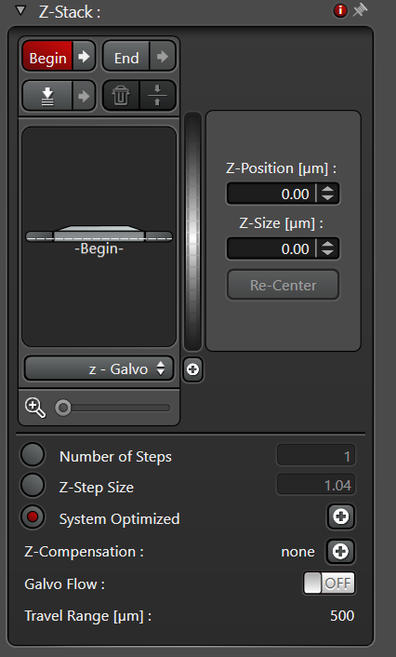
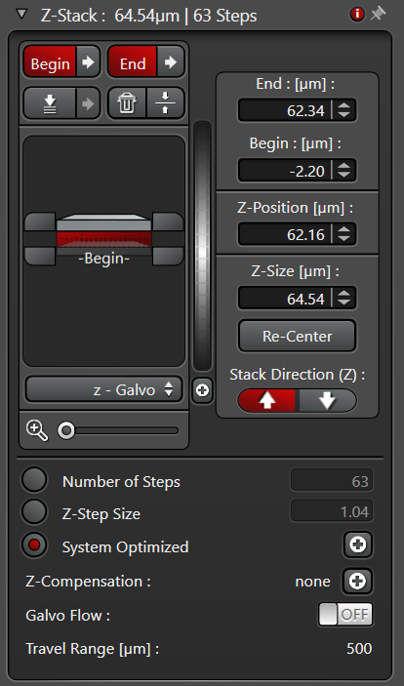
Z-Stack Imaging
Z Range
settings
Focusing method
settings
Focusing
method
settings
Select ‘xyz’ mode in the ‘Acquisition Mode’. Z-stack settings panel will show up.
Click the ‘begin’ and ‘end’ when you have reached to top and bottom of your samples. Step1. Press the ‘Live’ Button and go to the top position of your stack. Click the ‘Begin’ button, which will then turn red, meaning that the ‘Begin’ slider is locked for the top position of your stack. Step 2. Still in ‘Live’ Mode go to the bottom position of your stack. Click the ‘End’ slider, which will then turn red, meaning that the ‘End’ slider is locked for the bottom position of your stack.
Select ‘Focusing Method’- ‘Z-Galvo’ uses piezo stage, which has higher speed but with shorter range. ‘Z-wide’ moves the ‘Objective nosepiece’ mechanically, which is slower but with longer range.
Click ‘start’ to save the stack images

Slide 11
Time-lapse Imaging
Select ‘xyt’ imaging mode
Open the ‘time-lapse’ panel,
Define the ‘Time Interval’, e. g. 1 m
for taking images every 1 minute.
Define the ‘Duration’, e. g. 10min for
taking time-lapse images for 10
minutes.
Click “Start” to start the acquisition.
‘Xyt’
mode
Time Interval
Duration
NOTE: Time-lapse and Z-stack could work together if ‘xyzt’ mode is selected

Slide 12
Multiple Positions and Tiling / Stitching
For Tiling/Stitching:
• Activate button to show all saved positions
• Add positions that could be inside the tiled
area
• Remove positions if needed
• Select whether you want to stitch the
images right away (‘Merge images’), or in post-processing
When you “Start” the experiment, a rectangle containing all positions will be scanned and stitched.
Note: The Rotation has to be set to 90 degree!
Mark Positions
Tiling/Stitching
Mark Position
Tiling/Stitching
For Mark Positions (Mark&Find):
• Activate button to show all saved positions
• Add positions that should be scanned
• Remove positions if needed
When you “Start” the experiment, all
positions will be scanned.
Tiling/Stitching
90

Slide 13
Ex/Em Wavelength Scanning
For Emission Scanning:
Select ‘xyλ’ imaging mode
Open the ‘λ-Scan Range Properties’ panel,
Define the ‘emission scan range’ using ‘Detection Begin’ and ‘Detection End’.
Define the ‘Detection Bandwidth’ and ‘λ-Detection ‘Stepsize’.
Click “Start” to start the acquisition.
Excitation Scanning
Emission Scanning
For Excitation Scanning
Select ‘xyɅ’ imaging mode
Open the ‘Ʌ-Excitation Lambda Scan Settings’ panel,
Define the ‘Excitation scan range’ using ‘Excitation Begin’ and ‘Excitation End’.
Define the ‘Stepsize’.
Click “Start” to start the acquisition.

Slide 14
Save Acquired Images
Your images are saved in a single file (*.LIF). This file may contain multiple image series (xy, xyz, xyt etc.) that you acquired whenever you hit the ‘Start’ or ‘Capture’ button. Save your experiment by right clicking it and selecting ‘Save as’ from the menu.
Whenever a new image is acquired after clicking ‘Start’ or ‘Capture’, you can rename the current image (series) by right clicking it and selecting ‘Rename’ to give a proper name.
Right-clicking a ‘lif’ file will give you an option to ‘Export’ all images under the ‘lif’ file to the images in the TIFF (or another) format - all images can be exported once by one click. It is suggested export to TIFF in the raw data format.

